Slide 1
OCaml:
Tuples
CMSC 330: Programming Languages

Slide 2
Review
Function definition syntax
  let fun_name p1 p2 p3 … pn = body (* Currying *)
  let fun_name (p1, p2, p3, …, pn) = body (* fun of one arg *)
Function call syntax
  fun_name p1 p2 p3 … pn
  fun_name (p1, p2, p3, …, pn)
  Latter calls fun_name with ONE parameter, a tuple

Slide 3
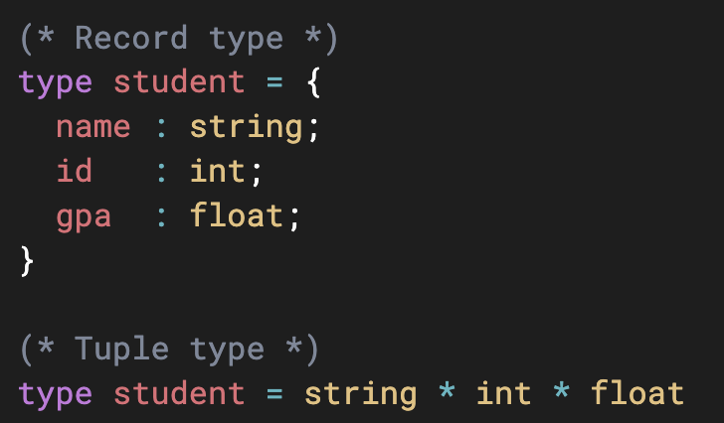
Tuples
Tuples are a product type
They simply group several values together
The components have no names, only positions
Records are also product types, but with named fields
Introduces a type alias; student is exactly the same as the tuple type: string * int * float

Slide 4
Tuple Syntax
How could we store a 2D point?
  We can represent a point as a pair of real coordinates
  Its components are accessed by position
What is its datatype (as a tuple)?
  type point = float * float
How can we create a new point?
  let my_point = (1.2, 0.0)
  let my_point : point = (1.2, 0.0)

Slide 5
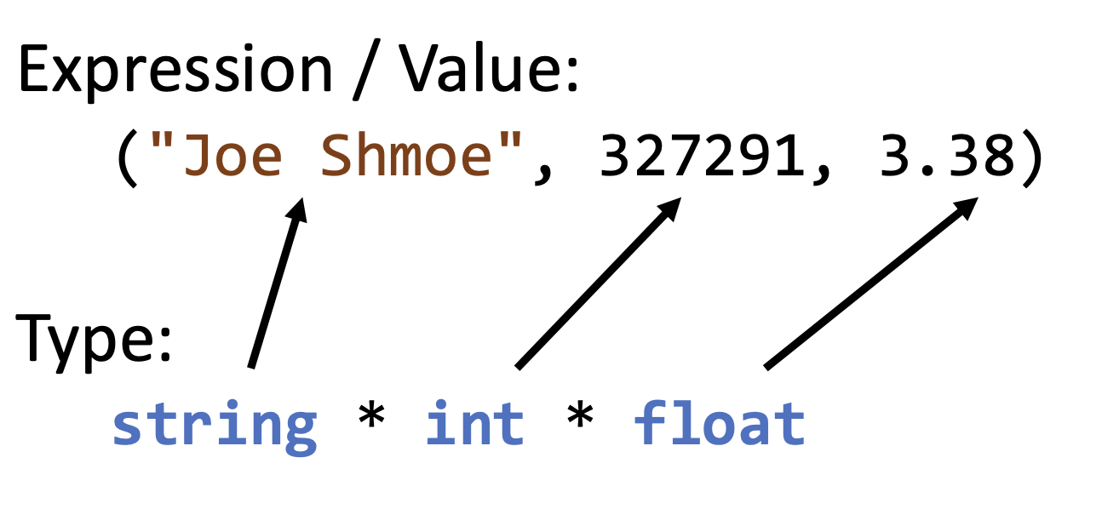
Tuple Syntax
Datatype of each element can be inferred
Immutable – you cannot change the value of a tuple
Can you find a CFG to describe tuple syntax
Notes:
tuple_expr:
| LPAREN expr COMMA expr_list RPAREN { tuple with 2+ elements }
expr_list:
| expr { last element }
| expr COMMA expr_list { element followed by rest }

Slide 6
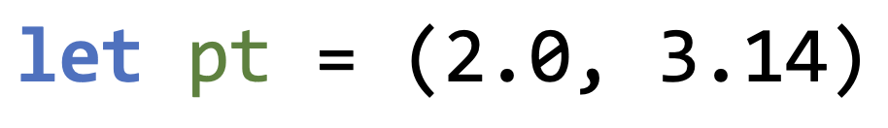


Tuple Bindings
Binding refresher: associating a name with a value
Extracting the first component (x) of the tuple
Extracting the second component (y) of the tuple
Note: _ is called a wildcard pattern, which matches a value but does not bind it with a name
Notes:
You can match both by using
let (x, y) = pt

Slide 7
Tuple: Example
let big = (1, 3.14, “hello”, true, 5)
What is the type of big?
  int * float * string * bool * int
Extract the 2nd, 4th, and 5th elements with ids “pi”, “emp”, and “num”
  let (_, pi, _, emp, num) = big
Compare the 1st, and 5th elements for equality (hint: local binding)
  let eq = … in first = last

Slide 8
Pattern Matching
Review: simple list pattern matching
    match l with
    | [] -> (* empty list do this *)
    | h::tail -> (* head h, rest tail, do this *)
Simple tuple pattern matching
    match p with
    | (0.0, 0.0) -> (* origin point do this*)
    | (x, y) -> (* other general point do this*)

Slide 9
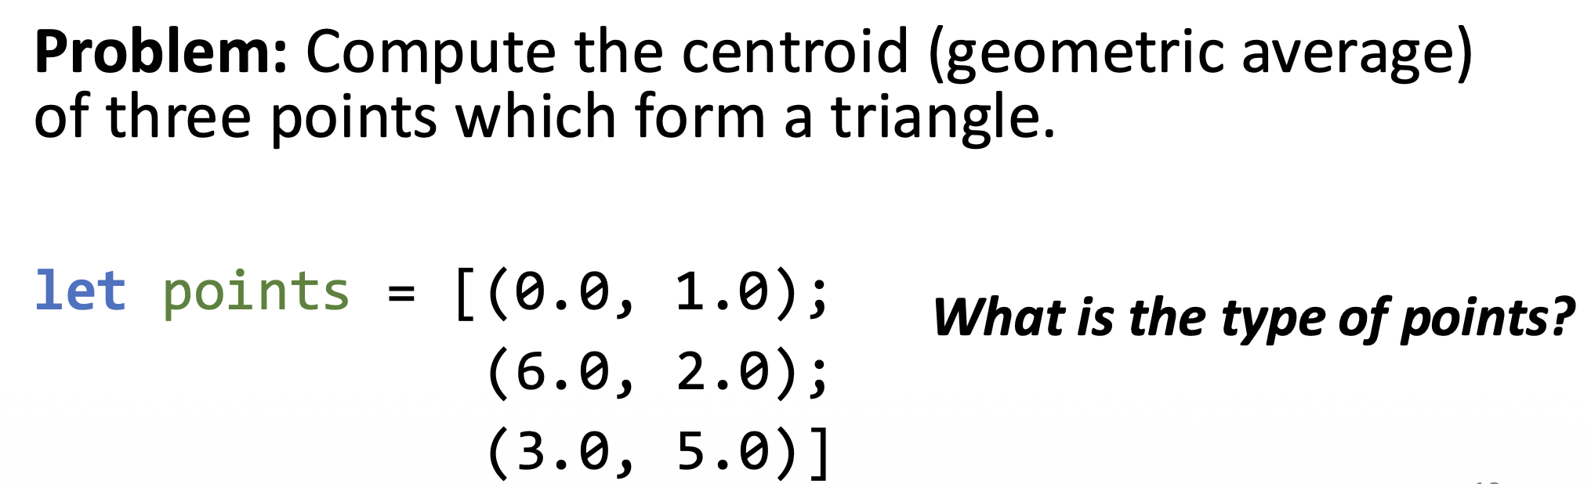
Pattern Matching
Tuples can lead to clean and expressive code when combined with pattern matching
Tuple pattern matching can be combined with other patterns (e.g., tuples inside a list)

Slide 10
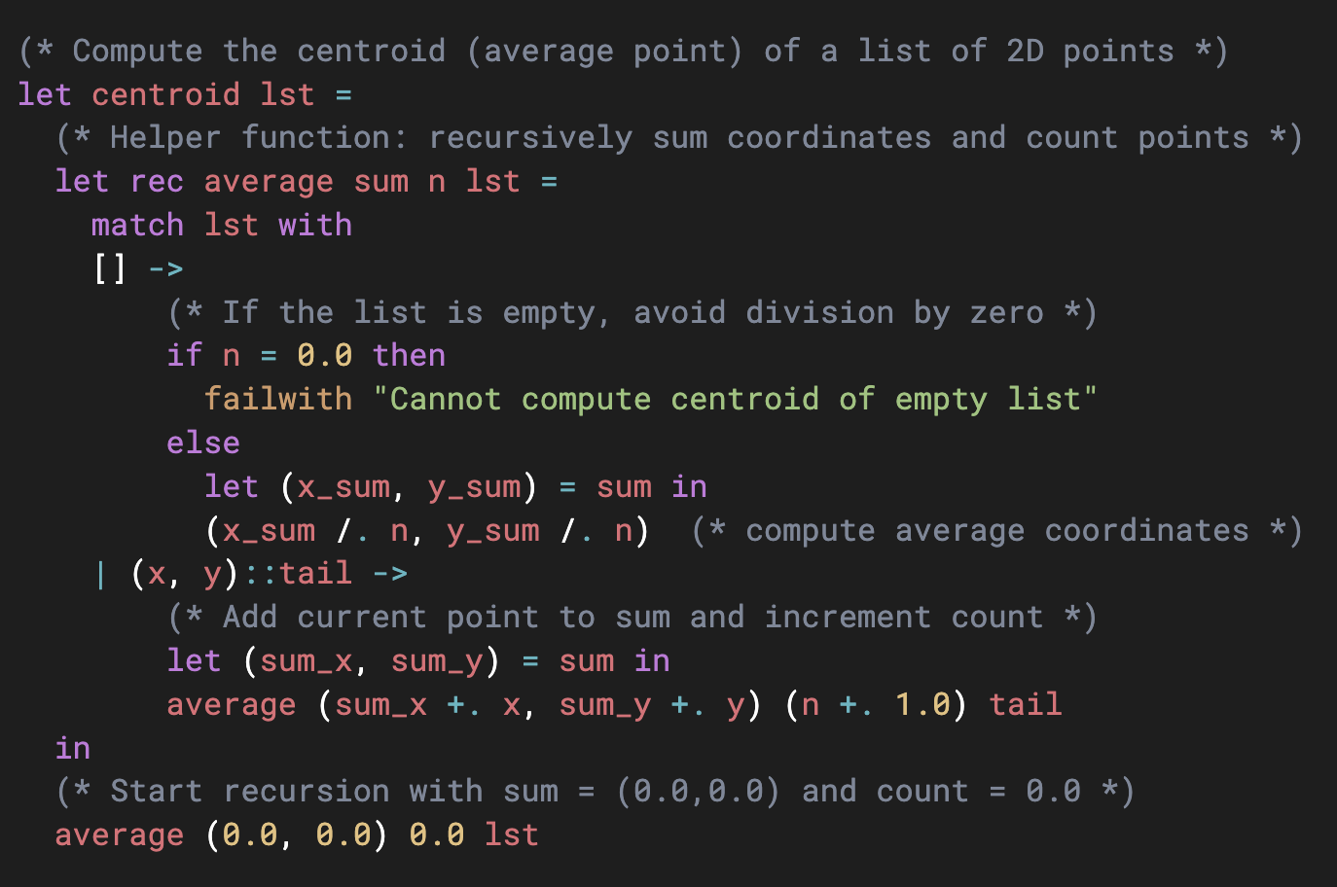
Centroid
Hint: let centroid lst =
      let rec average sum n lst =
      match lst with
      ...in...

Slide 11
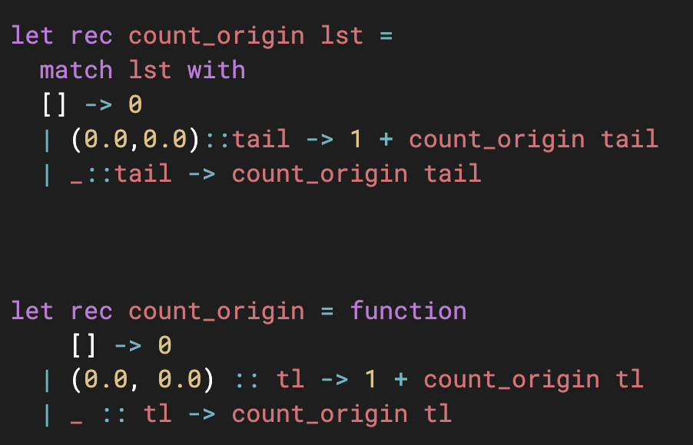
Count Origin Points
Count the number of origin points in a list
let rec count_origin lst =
Notes:
No DRY issues
This is way better (faster, use full pattern matching power):
1. If the pattern is a literal (like (0.0, 0.0) or true or 42), the generated code can jump straight to the right branch
2. No extra creation and comparison of tuples in recursive calls

